Slide 1
MARS Wrigley Cybersecurity Strategy – Phase 3
NIST Framework and Security Strategy

Slide 2

Introduction
Phase 1 and 2 overview
Focus on cybersecurity improvements
NIST Framework explained
Importance of global IT security
Protecting intellectual property, data
Enhance business continuity globally

Slide 3
Company Profile Recap
MARS Wrigley: Global confectionery leader
Top brands: M&M's, Snickers, Skittles
Operates in over 80 countries
Focus on innovation, sustainability
Technology supports global operations
Cybersecurity challenges remain significant

Slide 4
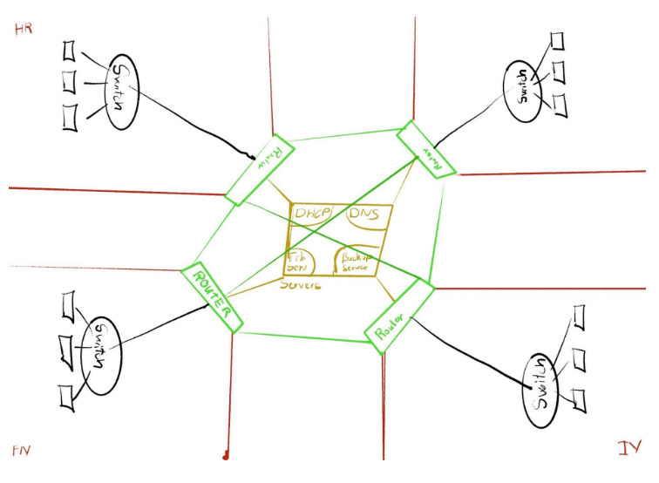
Technology Infrastructure Overview
ERP, CRM, digital marketing systems
Complex global supply chain networks
Protecting sensitive customer data
Managing intellectual property securely
Safeguarding critical operational systems
Adapting to evolving cyber threats

Slide 5
NIST Framework Overview
Identify
Protect
Detect
Respond
Recover
Identify risks, protect assets
Detect incidents, respond quickly
Recover systems, ensure continuity
Comprehensive, scalable, flexible framework
Aligns with international standards
Tailored to MARS’s global needs

Slide 6
Physical and Environmental Protection (PE)
Secure access: data centers, facilities
Use CCTV, fire suppression systems
Control temperature, humidity risks
Prevent unauthorized physical access
Protect critical infrastructure globally
Maintain business continuity efforts

Slide 7
Planning (PL)
Develop strategic cybersecurity policies
Regularly update security procedures
Perform routine risk assessments
Align with GDPR, CCPA regulations
Proactive response to evolving threats
Secure resilient global infrastructure

Slide 8
Personnel Security (PS)
Background checks, employee screening
Ongoing security awareness training
Role-based access to systems
Monitor insider threat vulnerabilities
Strengthen employee security practices
Mitigate risks of insider threats

Slide 9
Risk Assessment (RA)
Identify and evaluate cybersecurity risks
Prioritize key security vulnerabilities
Implement mitigation strategies promptly
Ensure supply chain risk management
Safeguard intellectual property effectively
Protect data and business operations

Slide 10
System and Services Acquisition (SA)
Define security standards for vendors
Assess new systems for compliance
Regularly monitor third-party services
Reduce risks from external systems
Securely integrate acquired systems
Strengthen IT procurement procedures

Slide 11
NIST Integration with MARS Strategy
NIST enhances existing security policies
Supports global data integrity efforts
Ensures compliance with regulations
Fosters safe innovation, R&D initiatives
Strengthens business continuity strategies
Safeguards sensitive company information

Slide 12
Conclusion
NIST framework secures global operations
Enhances protection of intellectual property
Mitigates cyber risks effectively
Ensures data integrity, business continuity
MARS ready for evolving cyber threats
Stronger, resilient global cybersecurity posture

Slide 13
References:
Kohnke, A., Sigler, K., & Shoemaker, D. (2019). Implementing cybersecurity: A guide to the NIST cybersecurity framework. CRC Press. DOI: 10.1201/9780429467999
Cichonski, P., Franklin, J., Huhn, M., Quinn, S., & Scarfone, K. (2020). Guide to cyber threat information sharing: Recommendations of the National Institute of Standards and Technology (NIST Special Publication 800-150). National Institute of Standards and Technology. DOI: 10.6028/NIST.SP.800-150r1
Ross, R., McEvilley, M., & Oren, J. (2021). Systems security engineering: Considerations for a multidisciplinary approach in the engineering of trustworthy secure systems (NIST Special Publication 800-160, Vol. 1). National Institute of Standards and Technology. DOI: 10.6028/NIST.SP.800-160v1r1
Souppaya, M., & Scarfone, K. (2020). Guide to enterprise patch management planning: Preventive maintenance for technology (NIST Special Publication 800-40). National Institute of Standards and Technology. DOI: 10.6028/NIST.SP.800-40r4
Pawlicki, T., Kim, G., & O'Sullivan, C. (2021). Risk management in the digital enterprise: Ensuring cybersecurity and data privacy in Journal of Enterprise Information Management, 34(1), 45-60. DOI: 10.1108/JEIM-10-2019-0324
Whitman, M. E., & Mattord, H. J. (2022). Principles of information security. Cengage Learning. DOI: 10.1108/JOEPP-12-2020-0126
Peltier, T. R. (2019). Information security risk analysis. CRC Press. DOI: 10.1201/9780367816033
Colwill, C. (2020). Mitigating insider threat: Protective monitoring for information security. International Journal of Critical Infrastructure Protection, 28, 120-130. DOI: 10.1016/j.ijcip.2020.100303

